Slide 1
IS-456: Database Management Systems
Module 3: Database queries and SQL Operators
Summer 2022
CityU of Seattle

Slide 2
Topics
Introduction to SQL
SQL Queries
Basic SELECT Queries & Statement Options
Data Languages
Create Table
MYSQL Syntax
Date Arithmetic
Summary
References

Slide 3
Introduction to SQL
Definition: Structured Query Language is a domain-specific language used in programming and designed for managing data held in a relational database management system (RDBMS), or for stream processing in a relational data stream management system (RDSMS).
Data Types
Character data
Numeric data
Date data

Slide 4
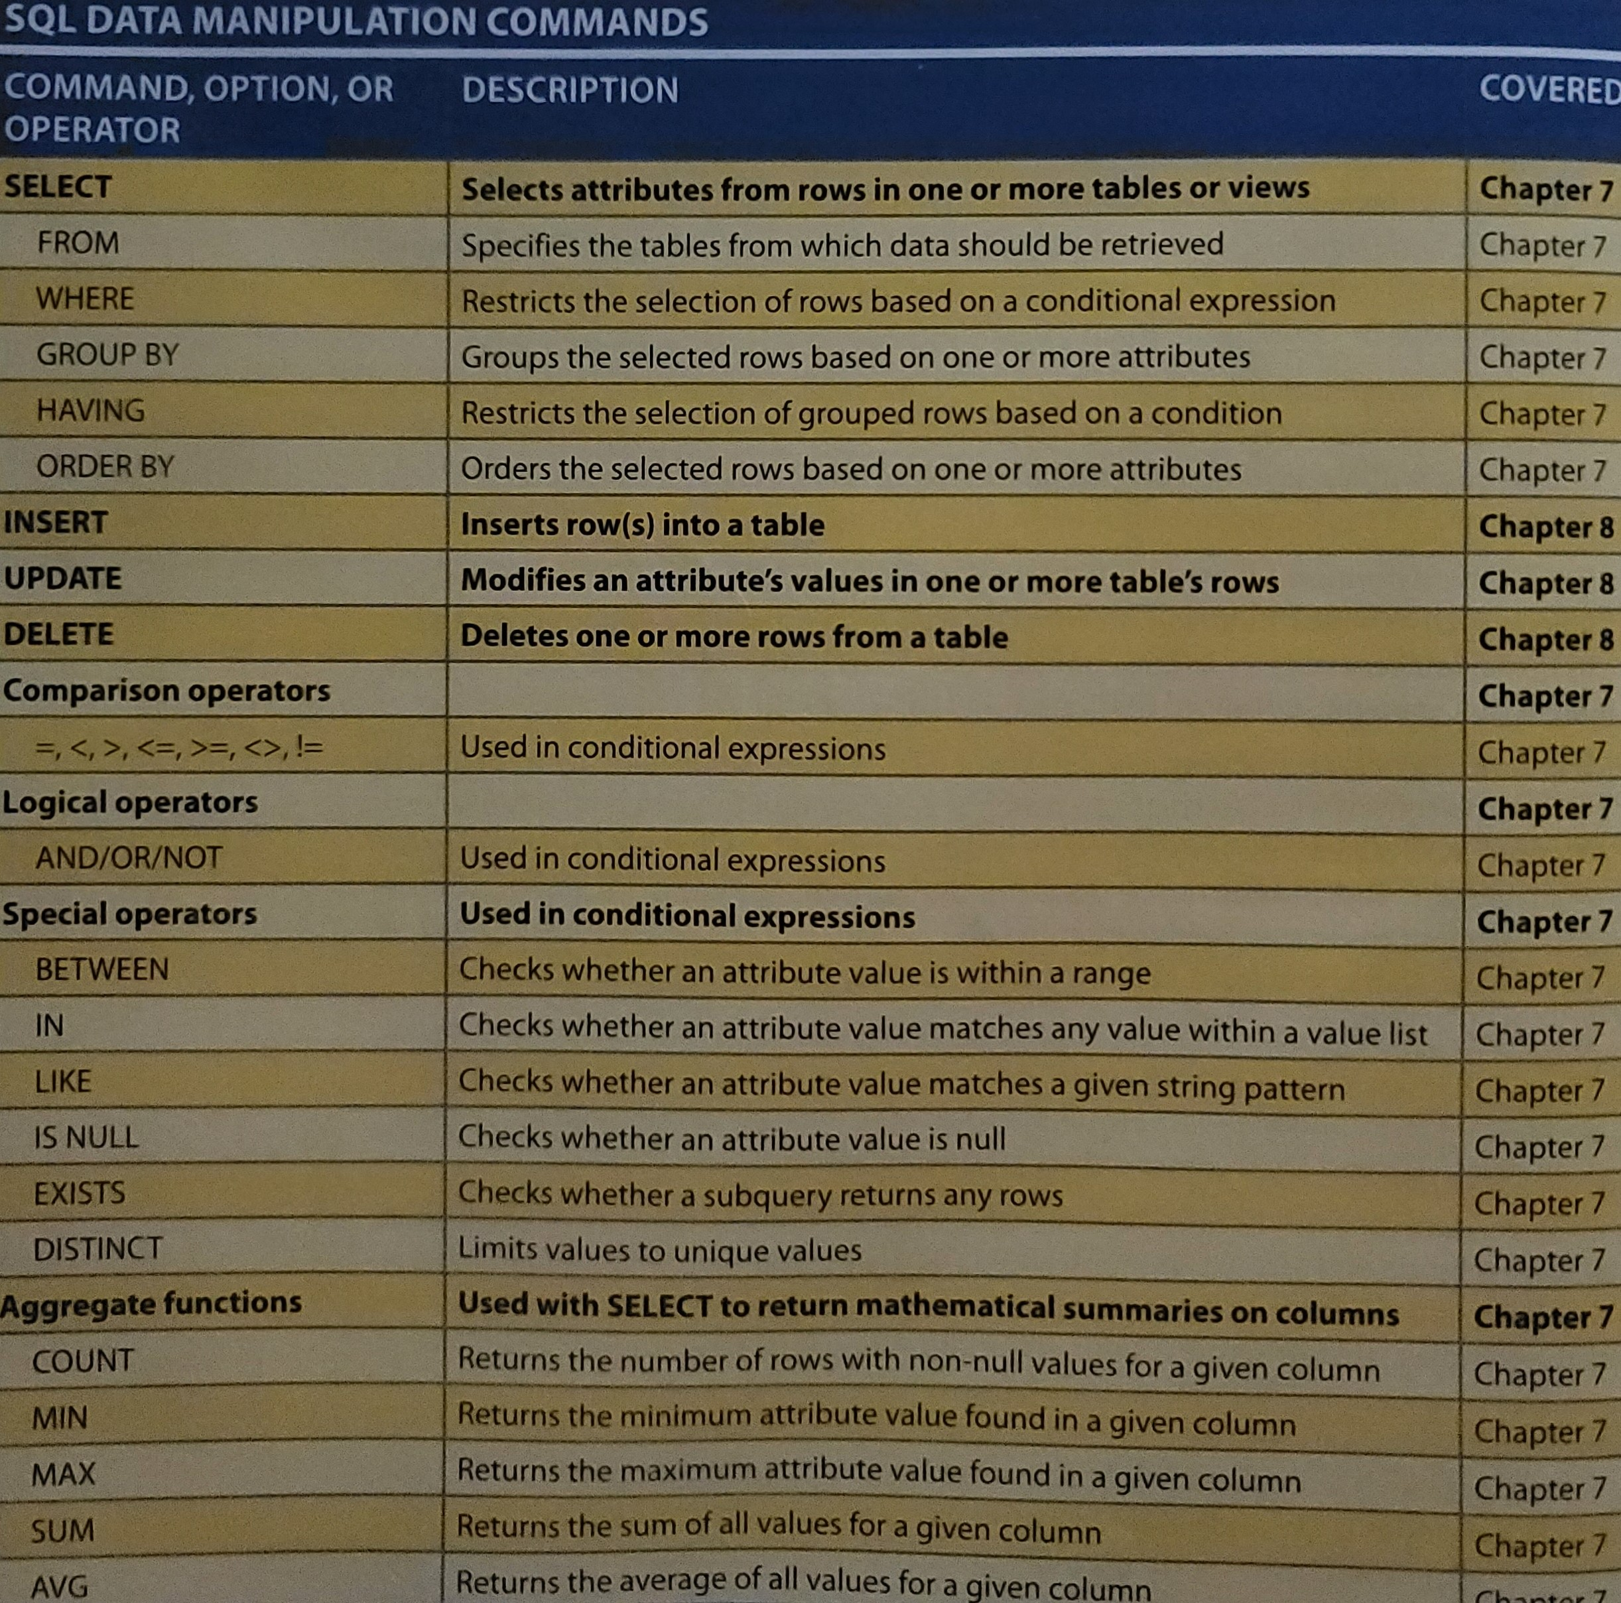

Slide 5
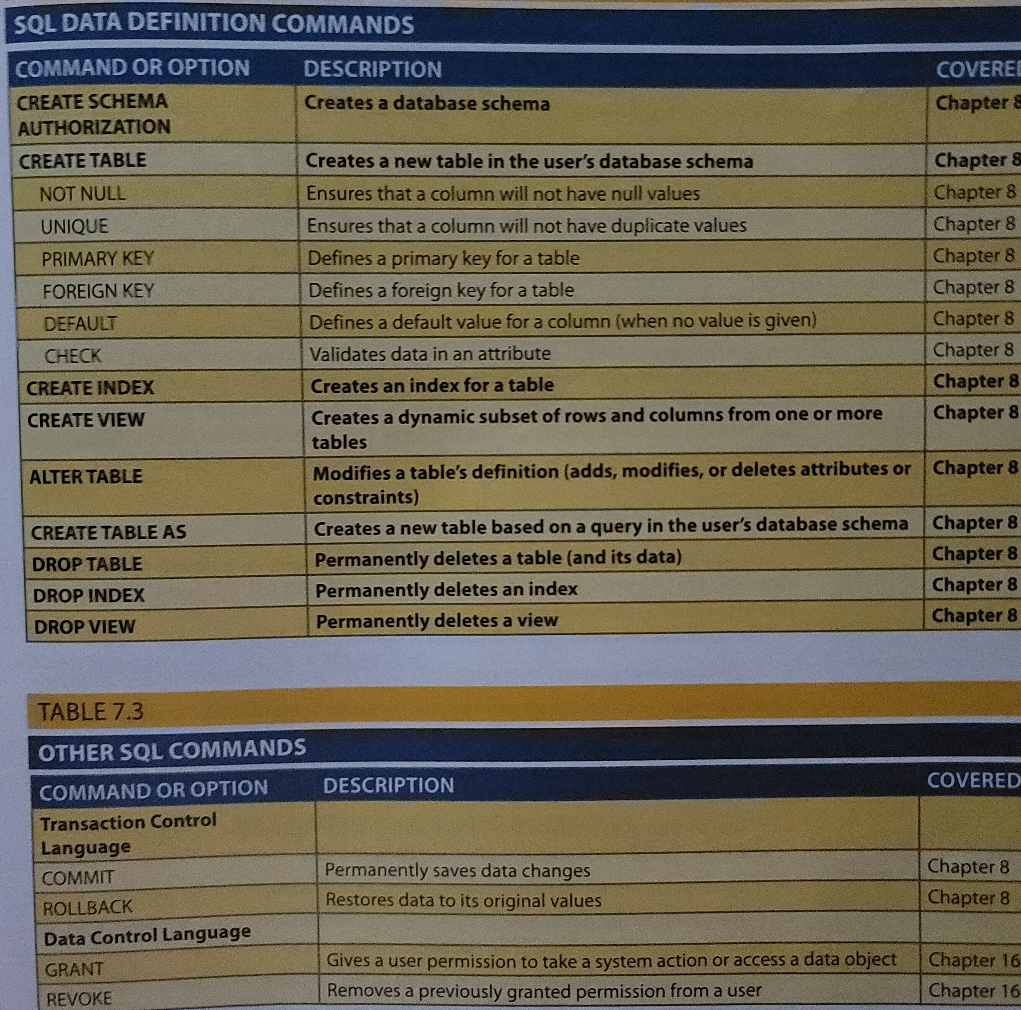

Slide 6
SQL Queries & SELECT Queries
Definition of “Simple database System”
Basic SELECT Queries
SELECT: specifies the attributes to be returned by the query
FROM: specifies the table(s) from which the data will be retrieved
WHERE: filters the rows of data based on provided criteria
GROUP BY: groups the rows of data into collections based on sharing the same values in one or more attributes
HAVING: filters the groups formed in the GROUP BY clause based on provided criteria
ORDER BY: sorts the final query result rows in ascending or descending order based on the values of one or more attributes

Slide 7
SELECT Statement Options
SELECT query specifies the columns to be retrieved as a column list;
SELECT columnlist
FROM tablelist;
(*) Symbol
Wildcard character
Example:
SELECT *
FROM PRODUCT;
(This query would return all of data from the PRODUCT table

Slide 8
Data language
Data Manipulation Language (DML)
Data Definition Language (DDL)
Transaction Control Language (TCL)
Data Control Language (DCL)

Slide 9
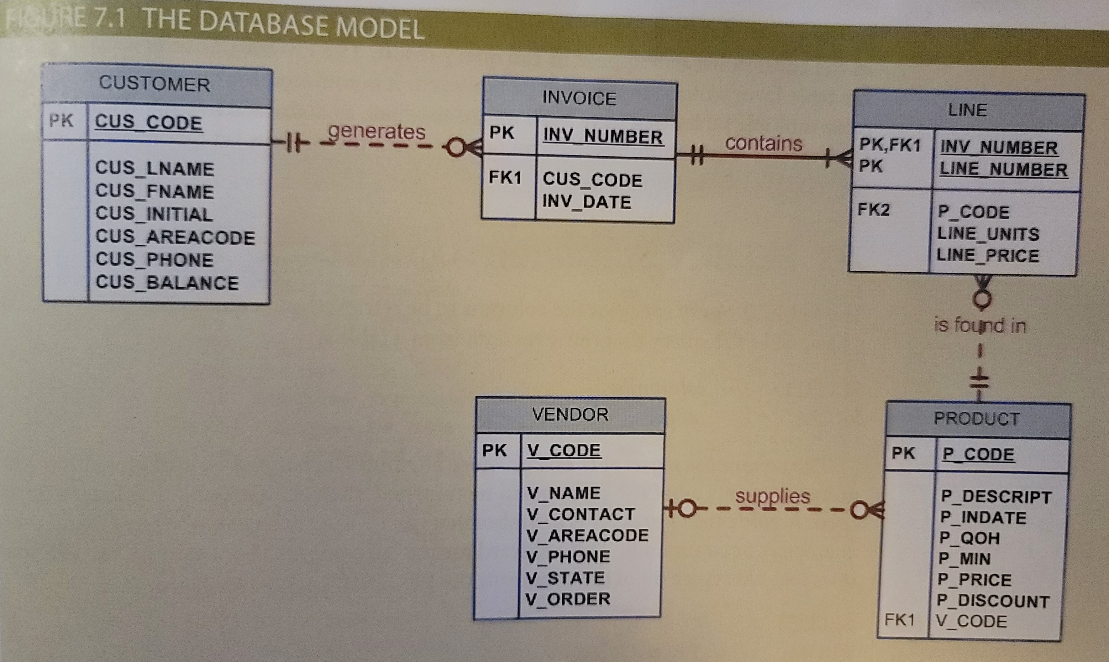
The Database Model
Simple database composed of the following tables is used to illustrate the SQL commands in this chapter: CUSTOMER, INVOICE, LINE, PRODUCT, and VENDOR.

Slide 10
CREATE TABLE
Creating a table involves naming the table and defining its columns and data type.
PK,UK,FK, and etc. can be defined for the columns while creating the table or could be defined later.
Syntax
Without PK
CREATE TABLE table_name
(
column 1 datatype,
column 2 datatype,
column 3 datatype,
column n datatype
);
NOTE: with PK, after the last statement, we should write:
CONSTRAINT constraint-name PRIMARY KEY (field-name)

Slide 11
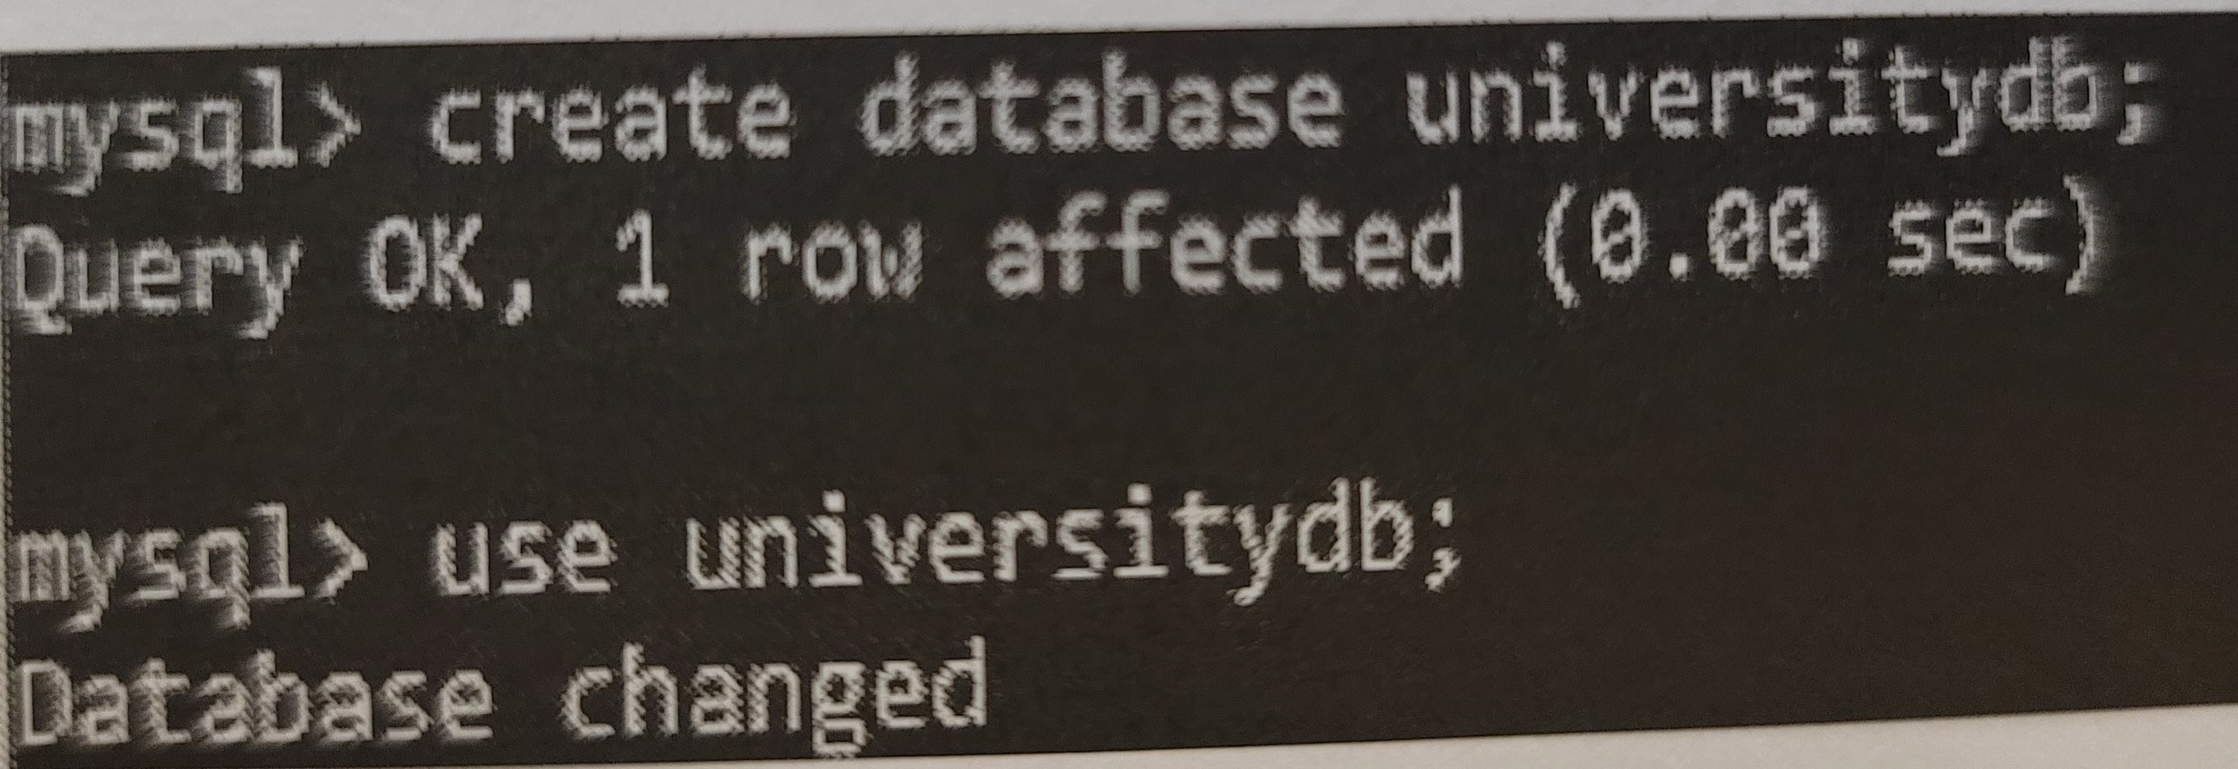
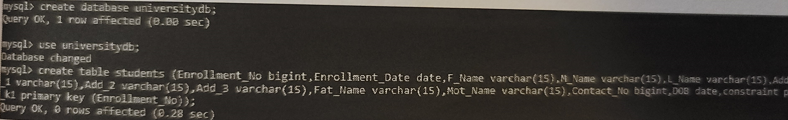
MYSQL syntax
In MYSQL syntax, first we have to create a database using CREATE command and then we have to switch to that database to start working.
EXAMPLE:
CREATE DATABASE universitydb;
USE universitydb;
And then we are going to create the Students table as follow;

Slide 12
Date Arithmetic
Computed Columns
DBMS stores a date value in a numeric format
Example:
If today’s date in some DBMS is the day number “250,000”, then tomorrow will be “250,001”, and yesterday was “249,999”.
Adding or subtracting a number from a date that is stored in a date data type returns the date that is the specified number of days from the given date.
Listing Unique Values
DISTINCT clause: produces a list of only those values that are different from one another.
Arithmetic Operators

Slide 13
Summary
SQL Definition
SQL Queries
Basic SELECT Queries & Statement Options
Data Languages
Create Table
MYSQL Syntax
Date Arithmetic

Slide 14
Resources
Mukesh Negi, (2019): Fundamental of Database Management System
Coronel C., Morris S., (2019): Database Systems, Design, Implementation, & Management
Adham Saeed, (2017): Role of Database Management Systems in Supporting Information Technology

